Slide 1
Partner Entity Presentations
Summer 2018
Urban Renewal Authority
Citizens Transportation Advisory Board
Downtown Review Board
Parks and Recreation Advisory Board
Commission on Aging

Slide 2
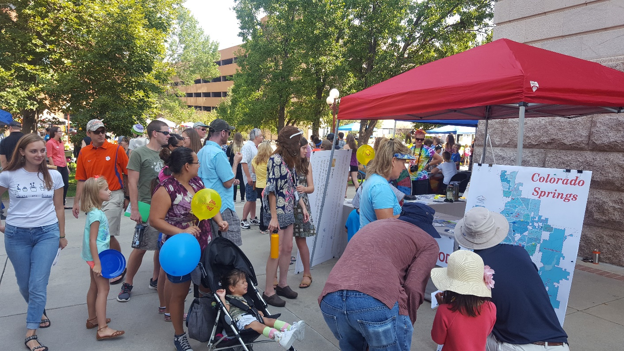
Meeting outcomes and Expectations
Overview of Process To-date and Highlights of Draft Plan
Next Steps and Input Process
Endorsement of Release for Community Input
Respond to Questions and High Level Planning Commission and Council Observations
Specific comments and recommendations can be provided in conjunction with community review

Slide 3
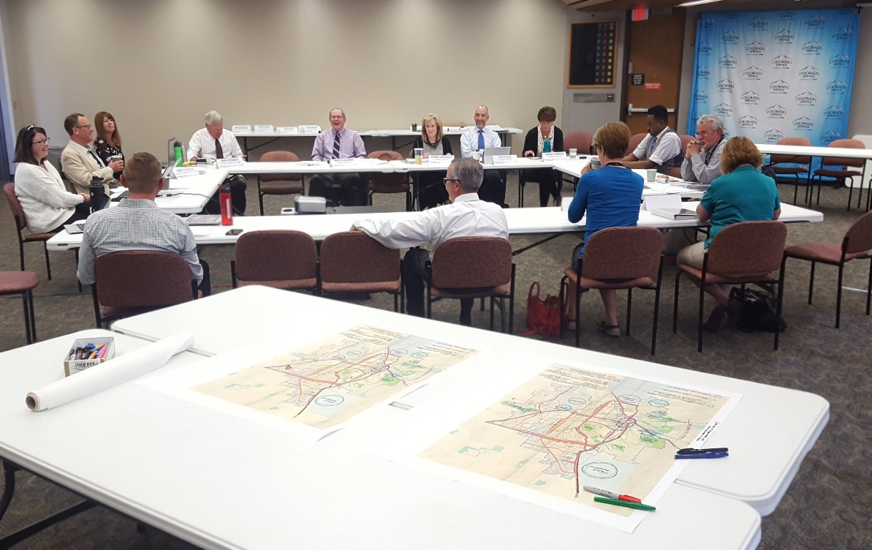
Active Steering Committee
Oversight, Major Content, Representation
Max Cupp
Rachel Beck
Hannah Parsons
Jim Raughton
Robert Shonkwiler
Maureen Juran
Kent Fortune
Charles Deason
Merv Bennett, Chair
Jill Gaebler, Vice Chair
Rhonda McDonald, PC
Susan Davies
Eric Philips
Josh Green
Tim Seibert
Doug Stimple
Taj Stokes
Harry Salzman

Slide 4
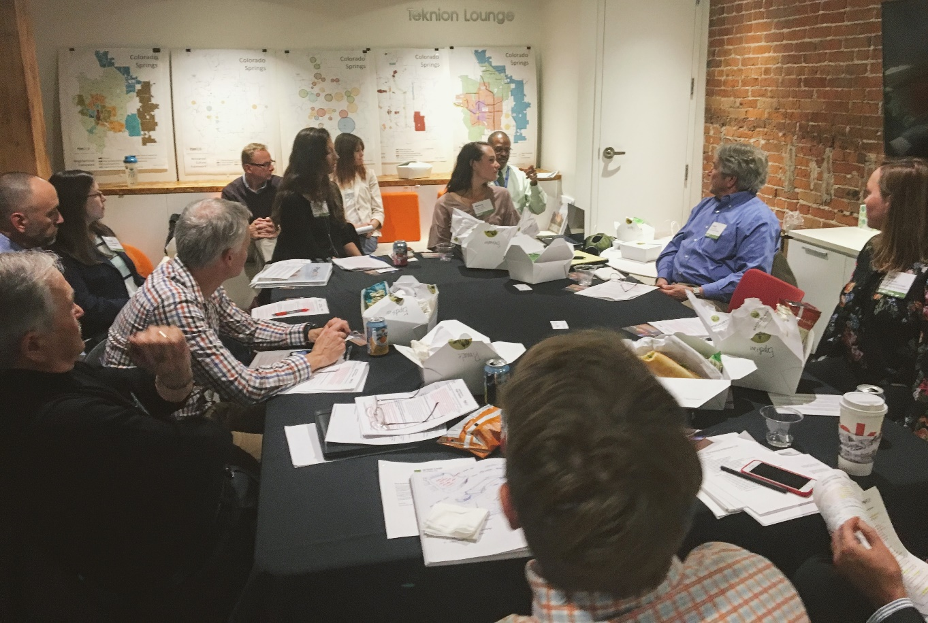
Practitioner’s Working Group
Peter Wysocki
Carl Schueler
Jeff Greene (invited)
Editing and user focus
Merv Bennett (invited)
Jill Gaebler
Doug Stimple
Tim Seibert
Mike Ruebenson
Amy Reid

Slide 5
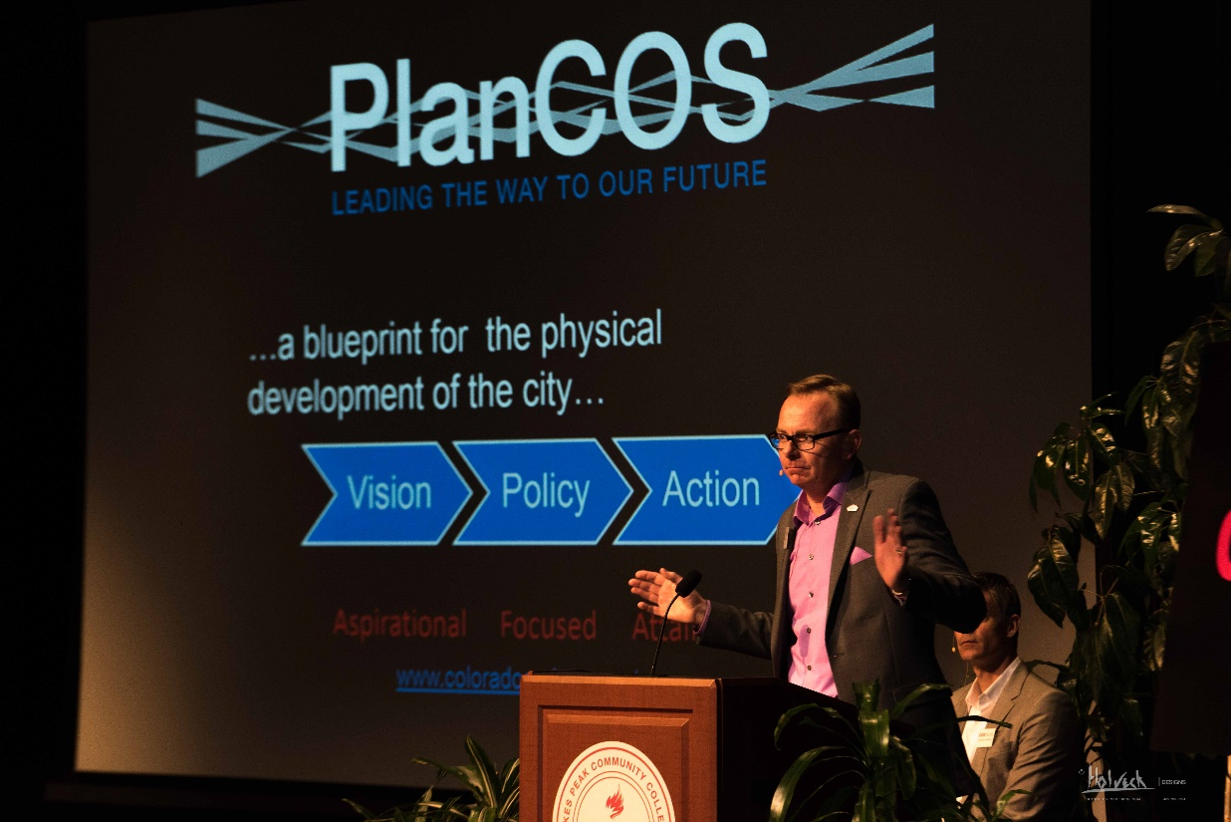
Staff and consultants
Logan Simpson
Bruce Meighen- lead
Megan Moore- PM
Miriam McGilvray- PM and primary drafter
City Planning Staff
Peter Wysocki- lead
Carl Schueler- PM
Conrad Olmedo- key support and public process lead
Page Saulsbury- key support and mapping- data lead
Entire City Staff team
Public Communications team
Technical Support Team

Slide 6
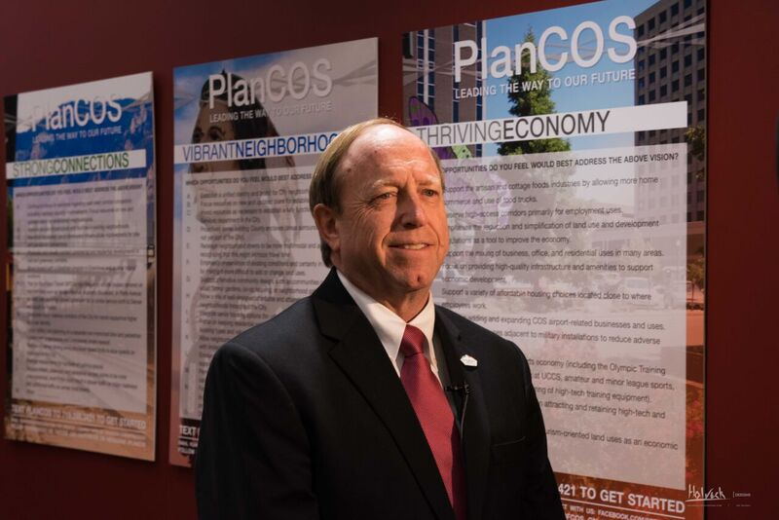
Summer Schedule
Press Conference/ Public Release
June 25th
Web Availability for Community Comment
June 25th- August 6th
City Council Open Houses
July 11th- ?
7 total (6 districts and at-large)
Focus for in-person outreach

Slide 7
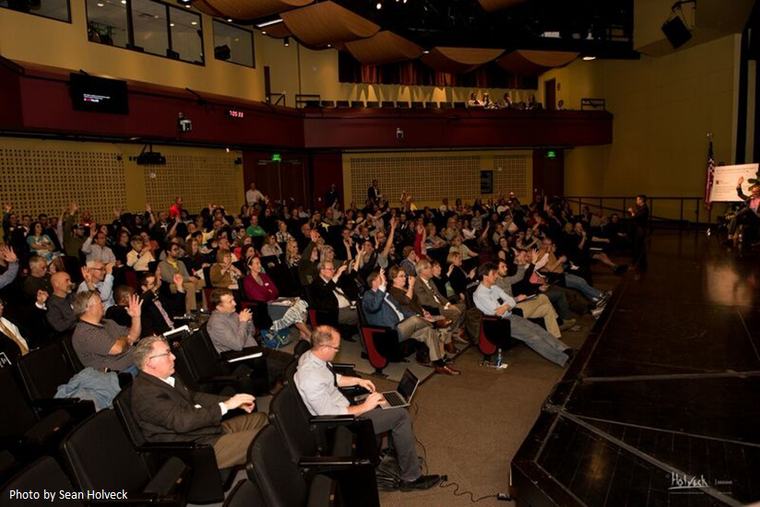
Review and Adoption Schedule
Key board and commission updates- summer
Web-based public input
June 25th to August 6th
Staff and Steering Committee review- August
Board and commission endorsements
September
Planning Commission
September- October
Council
October to December

Slide 8
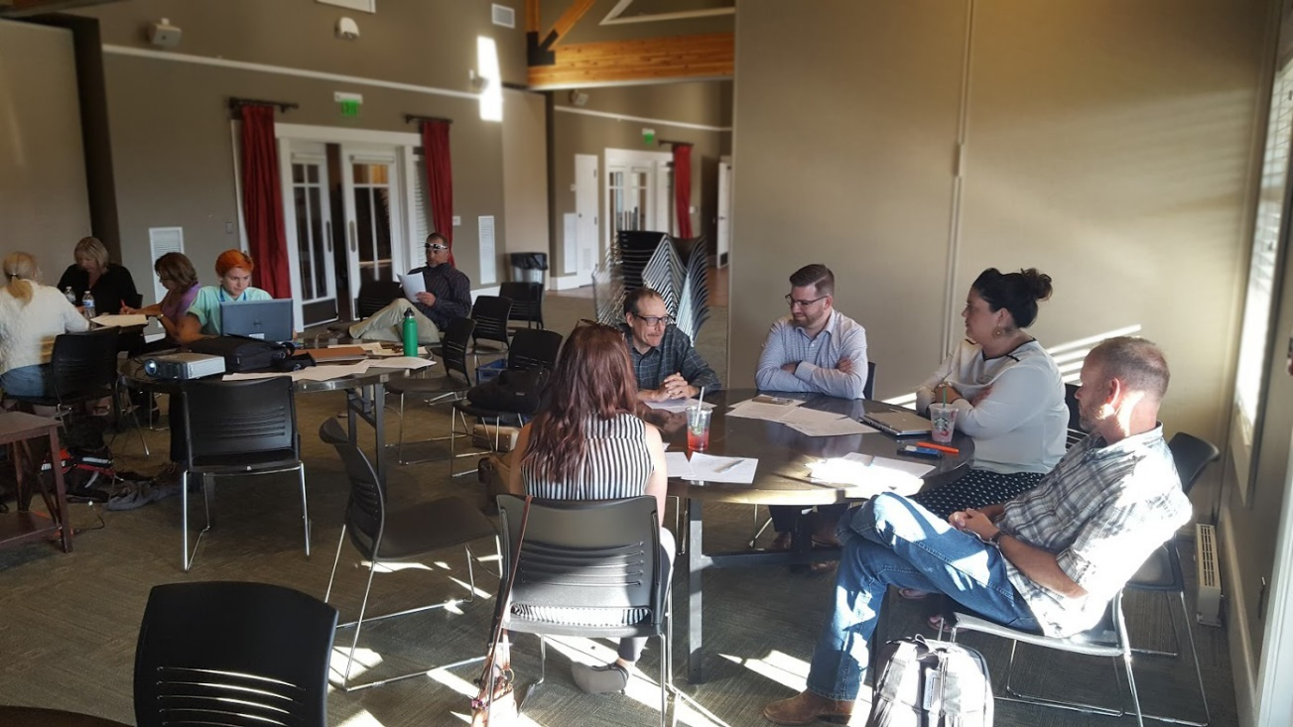
Highlights and Unique aspects of PlanCOS
High level plan
Depends on other plans and initiatives
Organized around Themes and not traditional chapters (e.g. “land use”, “transportation”)
Trends and assumptions
Big ideas
Keystone indicators
Typologies- Very Unique
Essential questions
Only a Vision Map
No detailed land use map

Slide 9
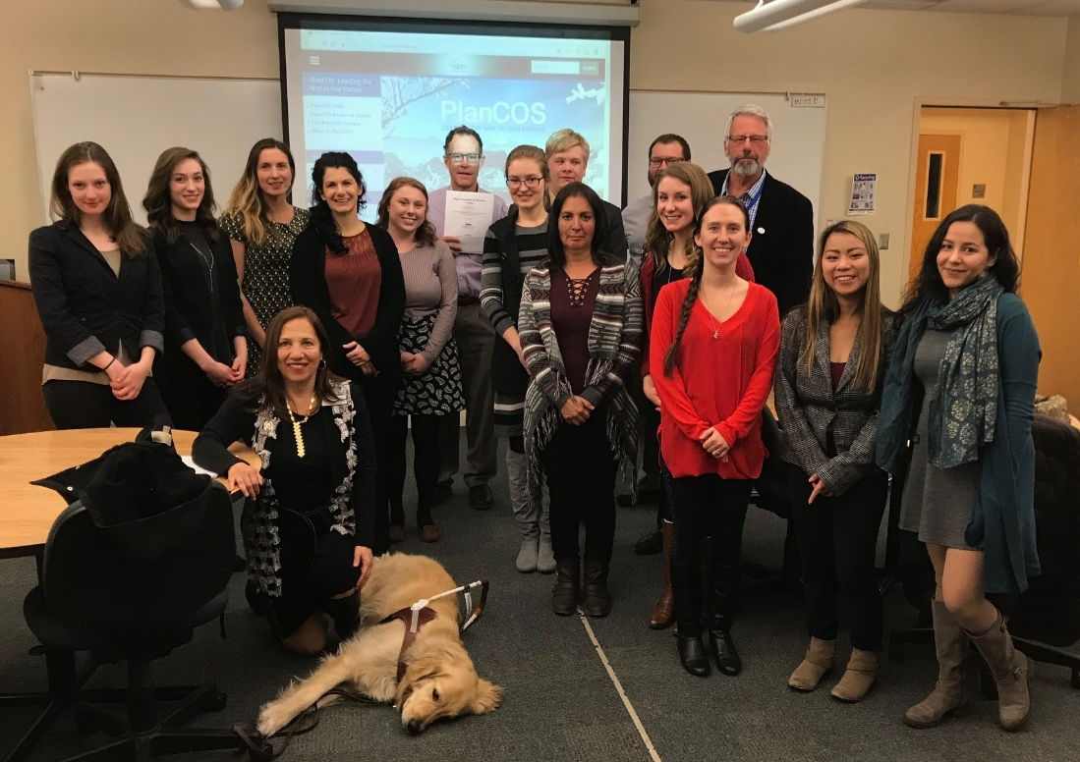
Process to Date
200+ Meetings and Events
Including topic and area-specific meeting
5,000+ Survey Reponses
Tours
Analysis
Many Comments
Innumerable Conversations
Staff Coordination (Technical Support Team)
100+ chapter drafts
13 PWG Meetings (Just this year!)
16 Steering Committee Meetings (so far)

Slide 10
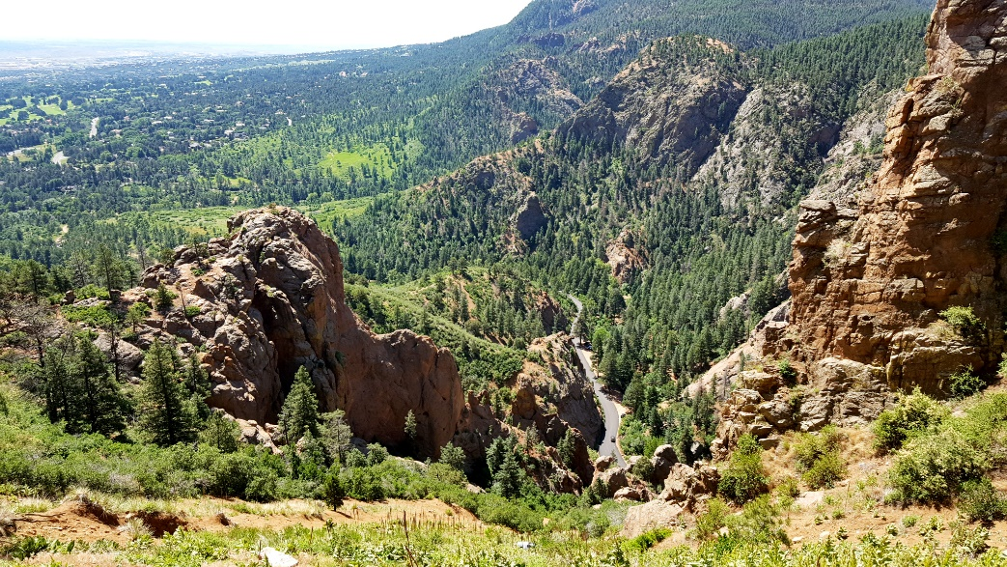
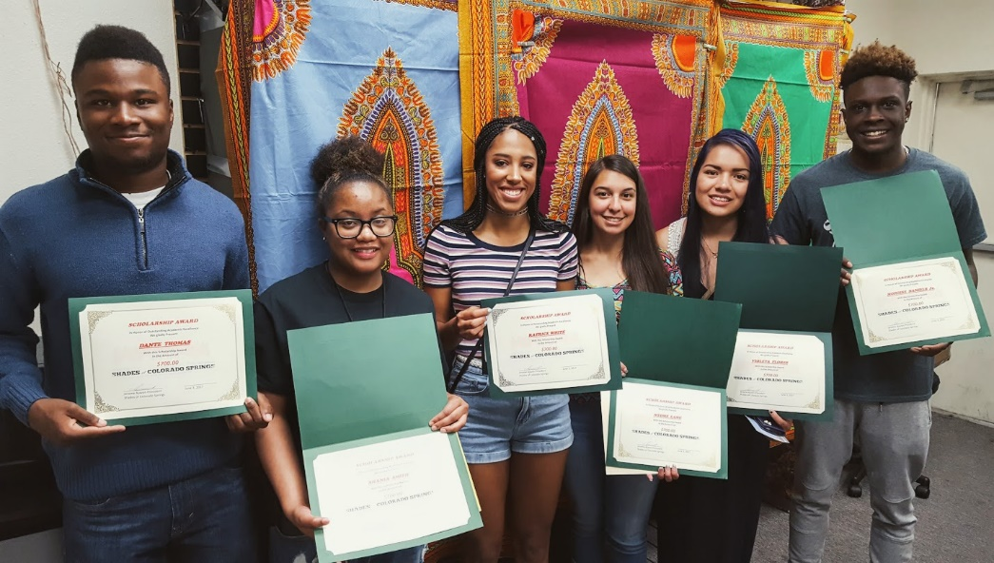
Vision
We will build a great city that matches our scenery
In the coming decades, Colorado Springs will become a vibrant community that reflects our engaging outdoor setting as pioneers of health and recreation.
Our city will be filled with unique places of culture and creative energy, sustainably designed around our natural environment.
We will attract and retain residents of all generations with an innovative, diverse economy and dynamic, well-connected neighborhoods that provide viable housing opportunities for all.

Slide 11
PlanCOS Themes
Vibrant Neighborhoods
Forms diverse and safe neighborhoods with quality gathering areas, a mix of housing types, transportation choices, and a shared sense of pride.
Unique Places
Centers on a vibrant Downtown and is strengthened by our reinvestment in walkable, healthy, and magnetic activity centers that are located in new and reinvented areas throughout the city.
Thriving Economy
Fosters an environment of inclusivity and economic diversity by attracting an innovative and adaptive workforce, advancing existing and targeted employment sectors, investing in quality of life, supporting our military, and expanding our sports ecosystem as Olympic City USA.

Slide 12
Themes- Continued
Strong Connections
Adapts to how we move by transforming our corridors to support our future generations’ health and mobility needs, enhancing economic vibrancy, upgrading infrastructure, and improving regional connectivity.
Renowned Culture
Promotes arts, culture, and education as essential parts of life, and embraces our identity and assets as Olympic City USA. This builds on the efforts of General Palmer and many others that envisioned culture as the cornerstone of the community and where creative energy generates new possibilities, interpersonal connections, and unprecedented philanthropy.
Majestic Landscapes
Values our outdoor spaces and celebrate our location at the base of America’s Mountain by designing a city oriented around our iconic landmarks. We ensure our community can engage with and enjoy these places through an integrated system of parks and natural areas.

Slide 13
Plan Chapters Follow from themes
Chapter
Chapter 1: Introduction
Chapter 2: Vibrant Neighborhoods
Chapter 3: Unique Urban Places
Chapter 4: Thriving Economy
Chapter 5: Strong Connections
Chapter 6: Renowned Culture
Chapter 7: Majestic Landscapes
Chapter 8: Adaptable Plan
Appendix

Slide 14
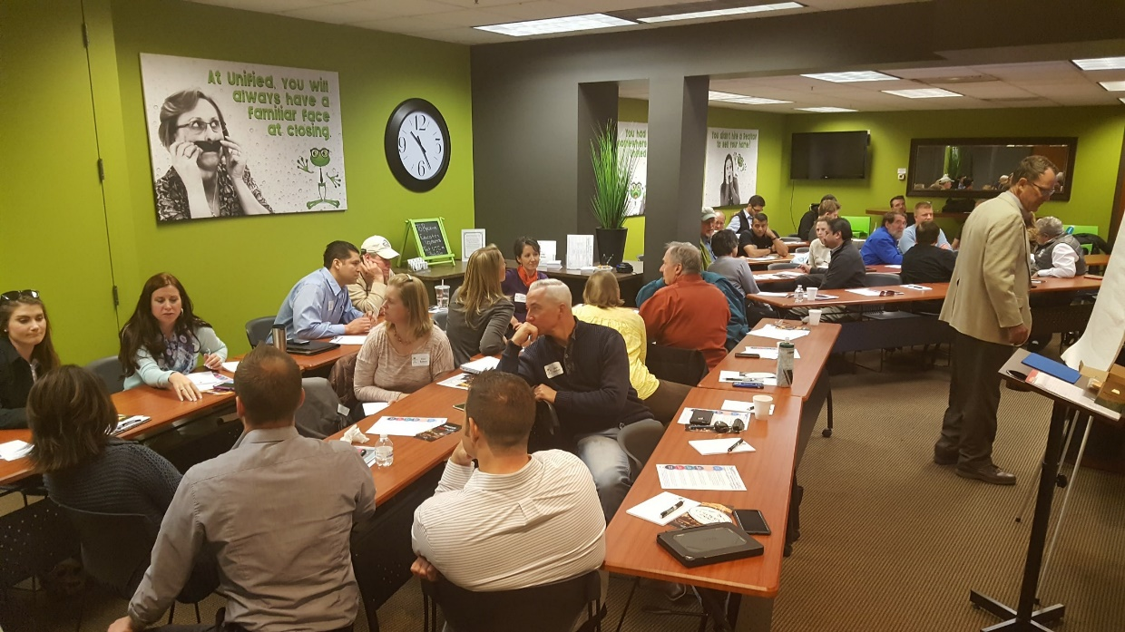
Standard Chapter (2-7) template
Importance
Trends and assumptions
Typologies, Framework Maps, Relationships
Goals, Policies and Strategies
Relevant Indicators
Essential Questions for City Initiatives
Relevant Plans and their Relationship

Slide 15
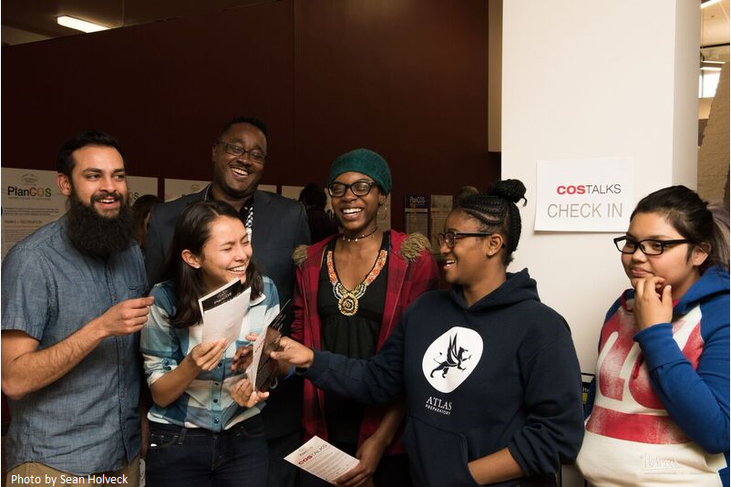
Chapter 1: Introduction
Big ideas
Capacity
We have a lot
Vision Map (in process)
High level use of plan

Slide 16
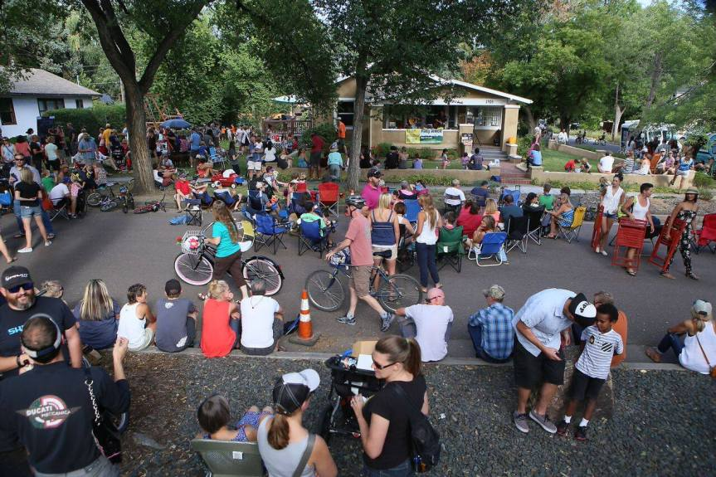
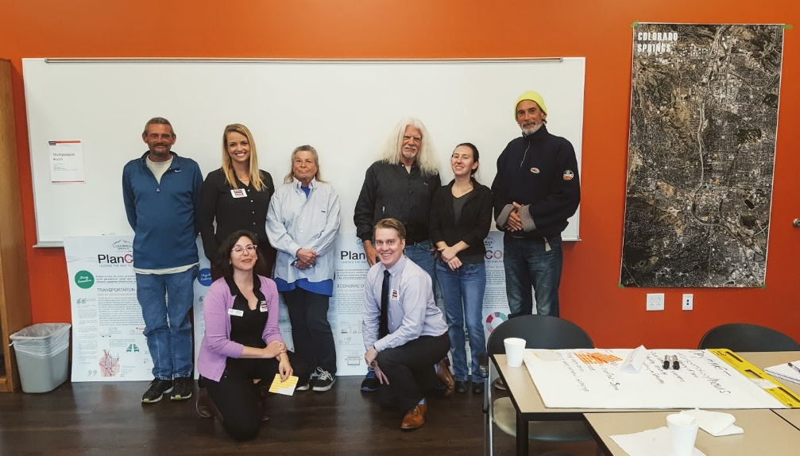
Chapter 2: Vibrant Neighborhoods
Housing for all
Affordable/ Attainable Housing
Neighborhood planning
Stretch goal of all neighborhoods

Slide 17
Commission on Aging

Slide 18
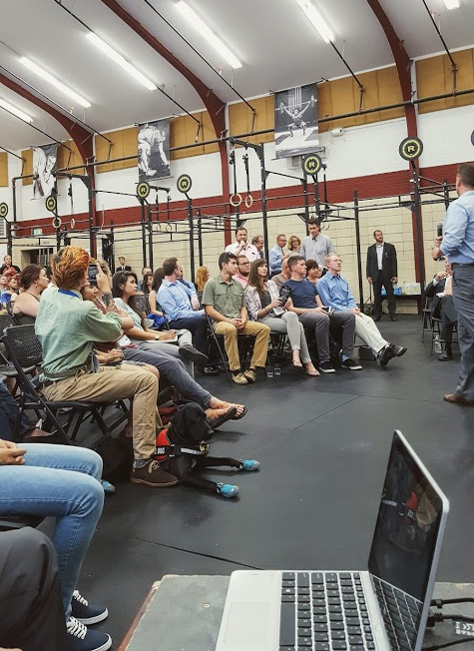
Chapter 3: Unique Places
Importance of Placemaking
Downtown- but not just downtown
Focus areas (corridors and centers)
Density in these areas
Infill and land use change emphasis
Primarily non-prescriptive approaches

Slide 19
Downtown Review Board

Slide 20
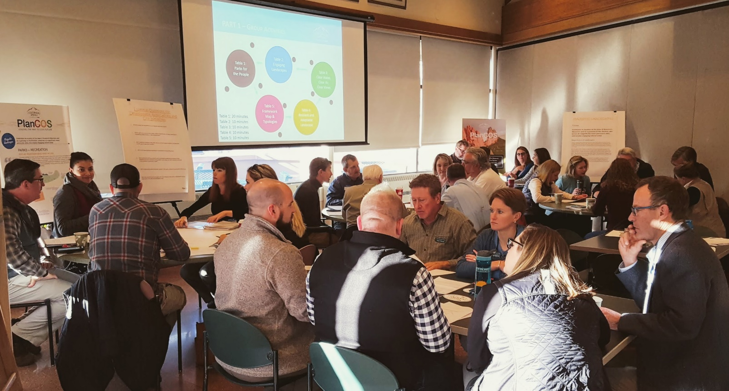
Chapter 4: Thriving Economy
Branding
Economic bases
Fiscal sustainability
Conversations about millennials/ youth and everyone else
Discussion of regional initiatives
Smart Cities

Slide 21
Urban Renewal Authority
Chapter 2 – Vibrant Neighborhoods:
Strategy 3.A-6: Where and when applicable, specifically incorporate mixed-use neighborhood building as an outcome tied to the use of urban renewal area designation, public/private partnerships and other tools and incentives to encourage redevelopment.
Chapter 3 – Unique Places
Strategy 4.D-3: Proactively involve the Urban Renewal Authority in identifying infill and redevelopment opportunities and targeting public infrastructure investments.

Slide 22
Urban Renewal Authority
Chapter 3 – Unique Places
South Tejon Street Redevelopment: Areas of South Tejon Street, around the repurposed Ivywild School, are being redeveloped with a particularly wide range of desired attributes. Tools and incentives including special districts and urban renewal are being used to support this redevelopment. The result is anticipated to be an especially unique, identifiable and livable urban environment.

Slide 23
Urban Renewal Authority
Chapter 6 – Renowned Culture
Strategy 3.E-4: Pursue the potential for incorporation of arts and cultural elements as part of approved urban renewal area plans.
Strategy 5.B-1: Explore available and dedicated funding sources for the arts associated with municipal projects, in exchange for unique incentives, such as Urban Renewal designation, and locally supported proposals for special financing districts.
Urban Renewal Master Plans

Slide 24
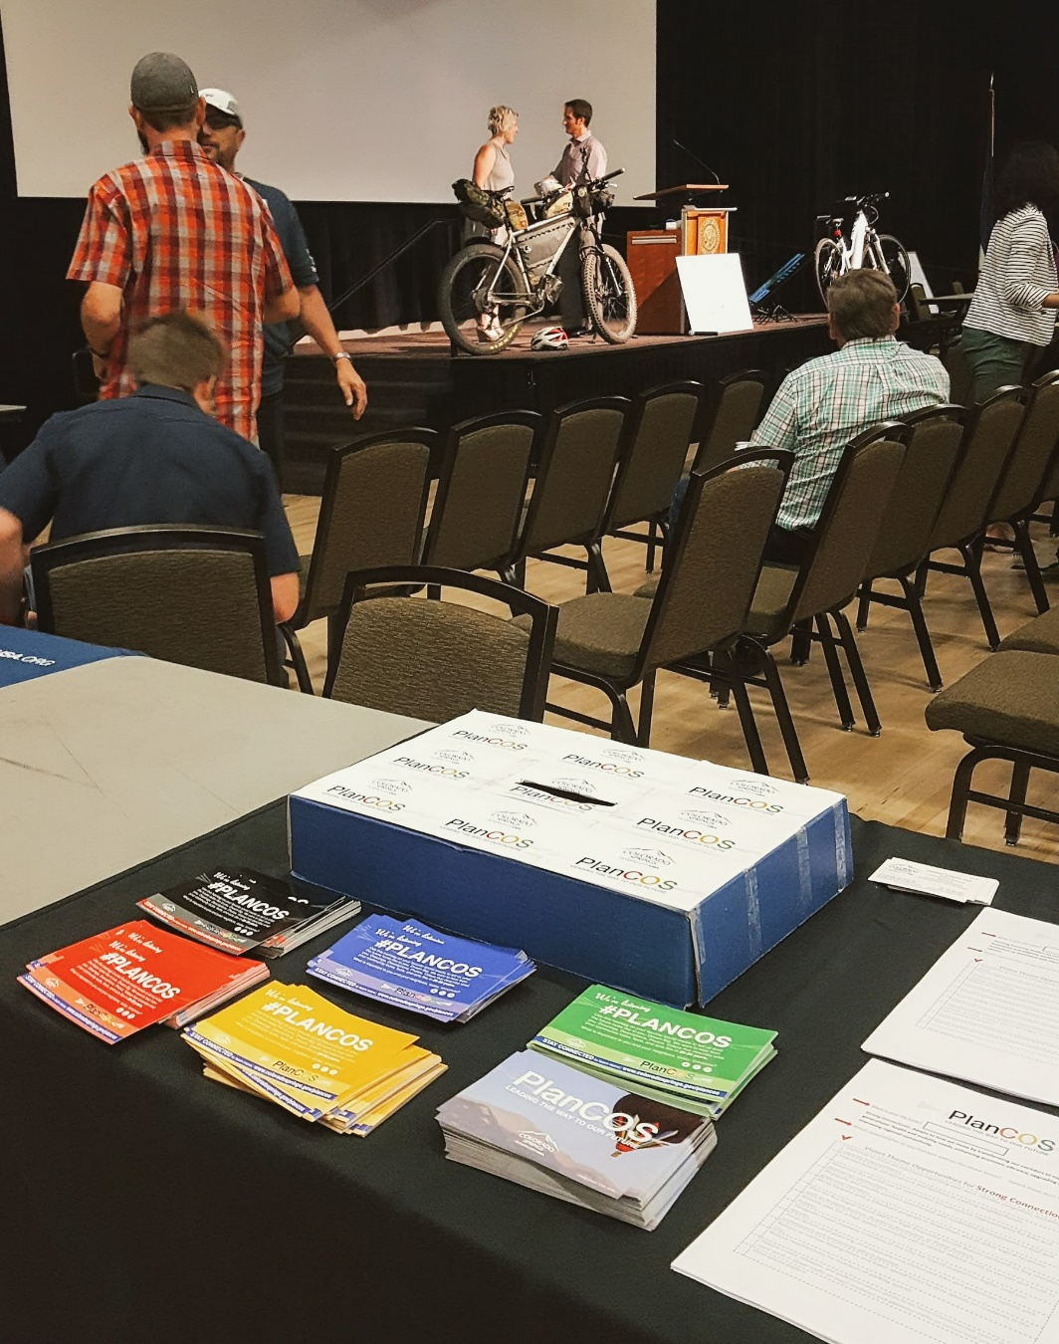
Chapter 5: Strong Connections
Transportation and Utilities
Stormwater (here and in Majestic Landscapes)
Technology and demand uncertainty
Transit stretch goal
Slower/ narrower very local streets
Walkability
De-emphasis on more lanes, grade separation, and access control
Focus on taking advantage of technology
New future for utilities
Technology and smart systems

Slide 25
Citizen Transportation Advisory Board

Slide 26
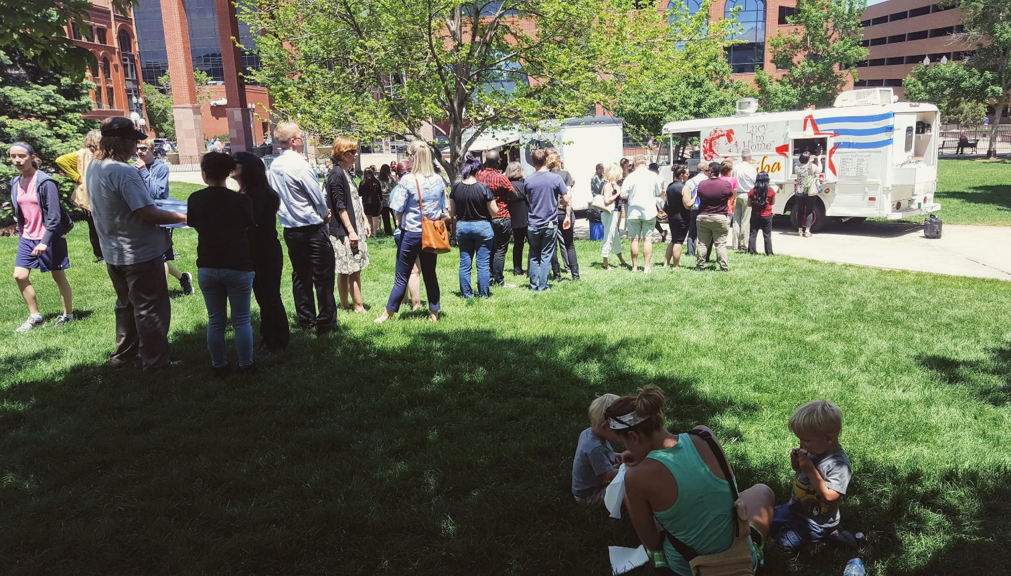
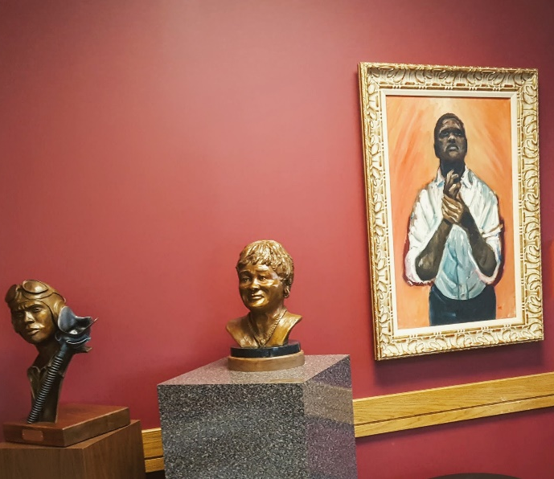
Chapter 6: Renowned culture
Very unique plan element
Includes arts, culture, education and tourism
Importance investing in fixed places and adaptive “pop-up” culture

Slide 27
Commission on Aging

Slide 28
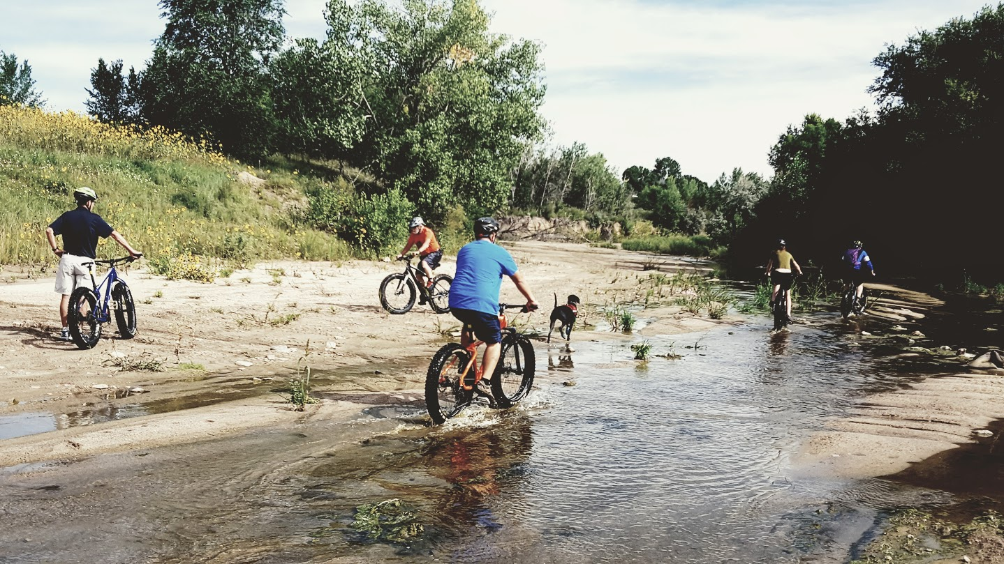
Chapter 7: Majestic landscapes
Very big emphasis in community process
Sustainable funding
Complete creeks
Local food
Resiliency

Slide 29
Parks and Recreation Board

Slide 30
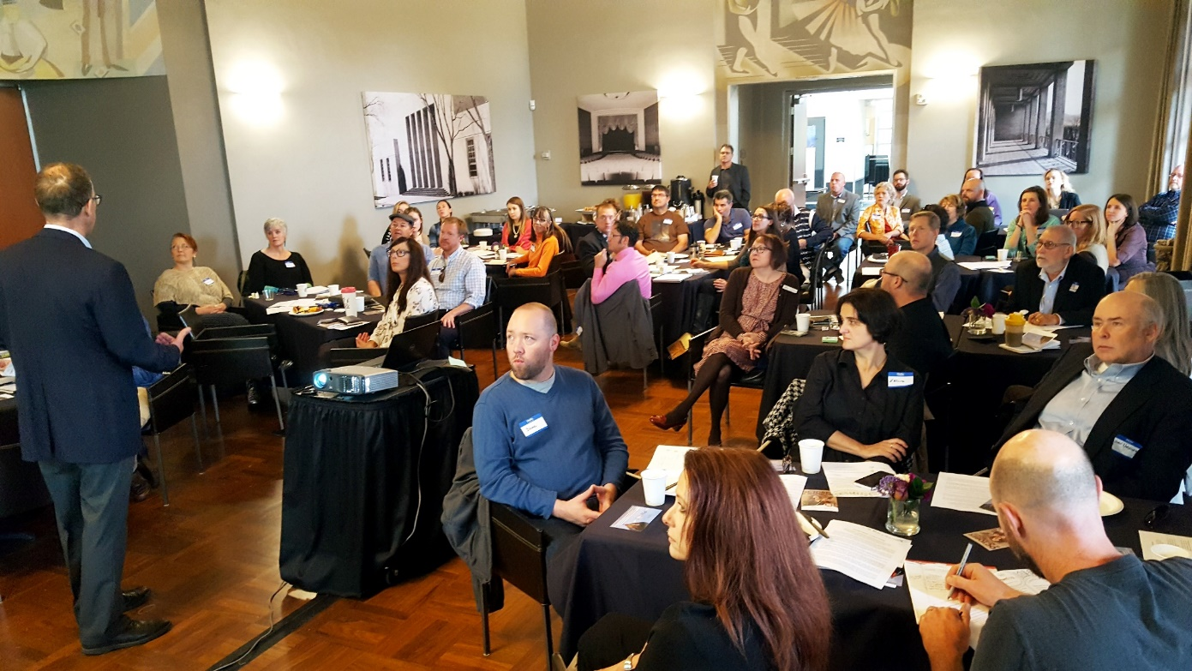
Chapter 8: Adaptable Plan/ implementation
Chapter 8 Outline
Keystone Indicators and Progress Monitoring
Key Projects and Implementation Strategies
Responding To Changing Conditions (Intro)
Using the Plan
Annexations
Amending the Plan

Slide 31
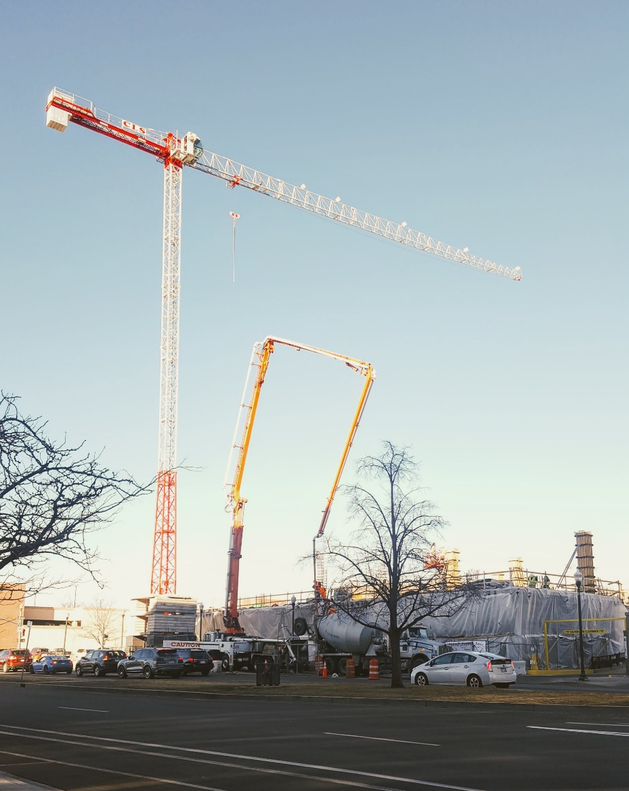
Using the Plan
Development Review
City Initiatives
Monitoring Progress

Slide 32
Chapter 8: Amending the Plan
Types of Amendments
Revisions to Online Content and Format
Minor Administrative Amendments
Major Plan Amendments
Plan Updates

Slide 33
Indicators and Monitoring
Keystone Indicators
New Residential Net Density
Net City Lane Miles Added
Number of High Priority Neighborhood Plan Completed
Infill and Redevelopment Activity
Housing Affordability
Existing Downtown Measures
Economic Indicators
Renowned Culture Indicators
Majestic Landscapes Indicators
Walkscore®, Bikescore® and Transitscore®

Slide 34
Typologies
Examples from COS
Way of addressing complexity and size of city
Idea of how to “move the needle”
Representative and directional

Slide 35
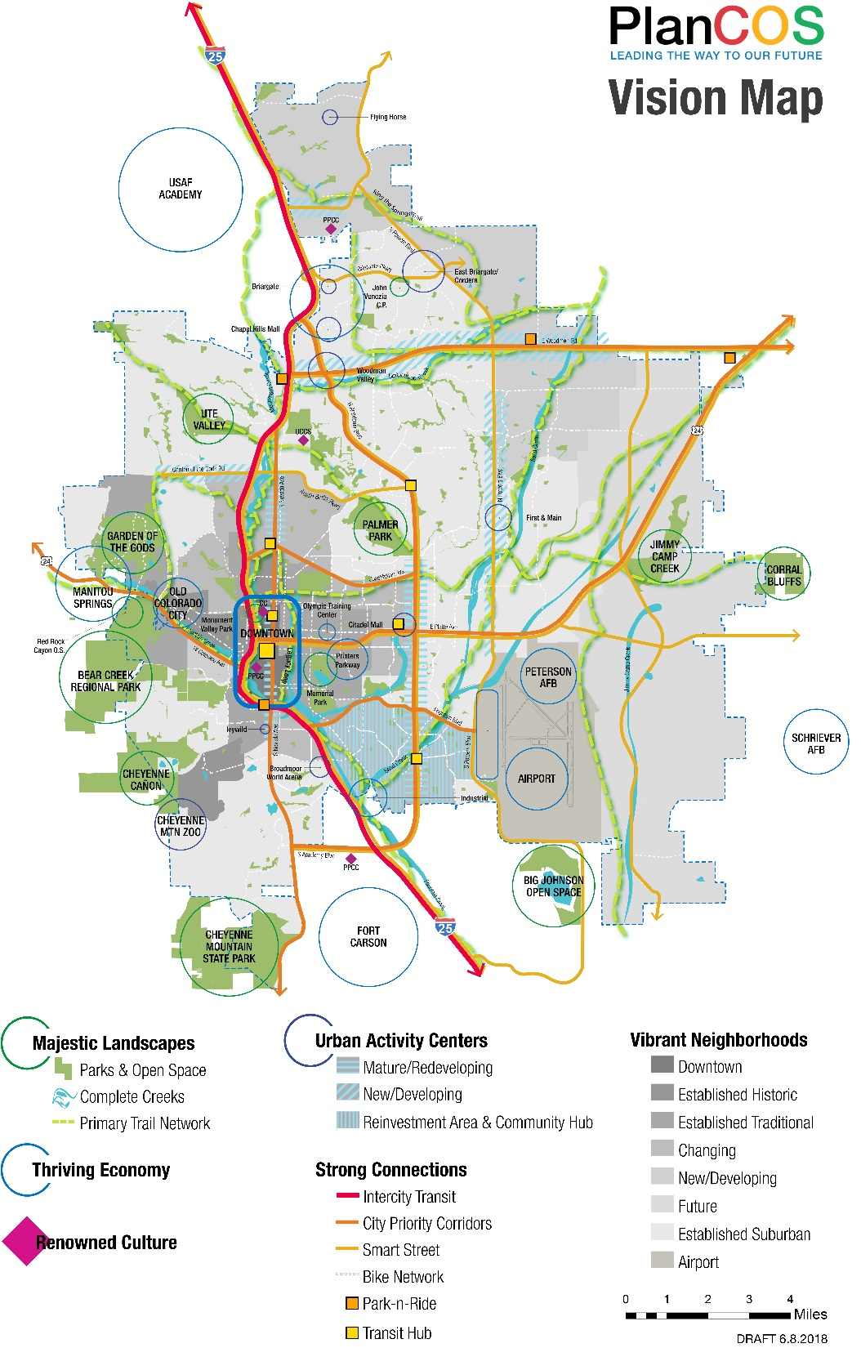
Vision Map
Conversation starter
Transit hubs (3+ bus route intersections)
Legacy Loop & Ring the Springs
Visionary enough?

Slide 36
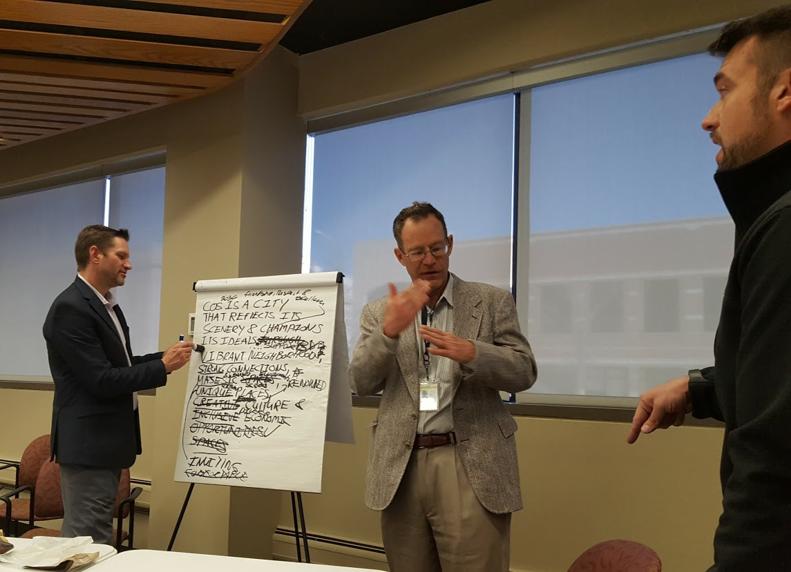
Recommended Initiatives and Resource Implications
Most Important Implementation Initiatives
Update Zoning and Subdivision Code
Intermodal Mobility Plan
Neighborhood Planning Program
Attainable Housing Plan
SmartCOS Plan
Annexation Plan Update
Other
Annual Reports
Strategic Plan
Sustainable Parks and Transit Funding

Slide 37
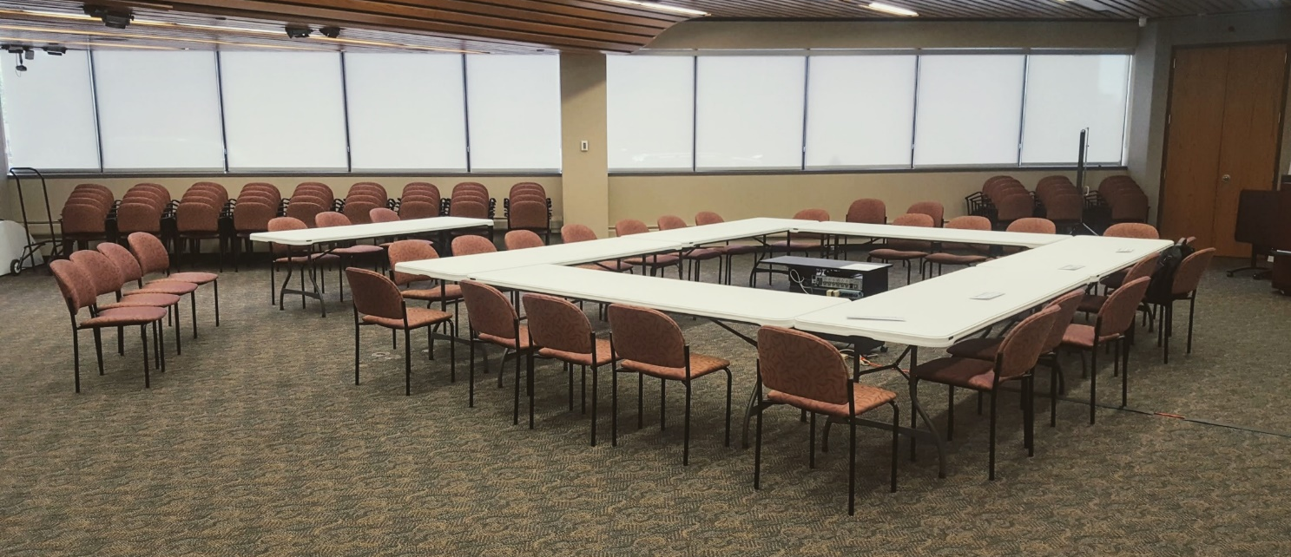
Tasks to Complete
Vision Map Refinement
Can be part of public process
Framework Maps
Refine land capacity analysis
Consultant memo on PlanCOS fiscal analysis
Convert document to publishable form
Pre and post adoption

Slide 38
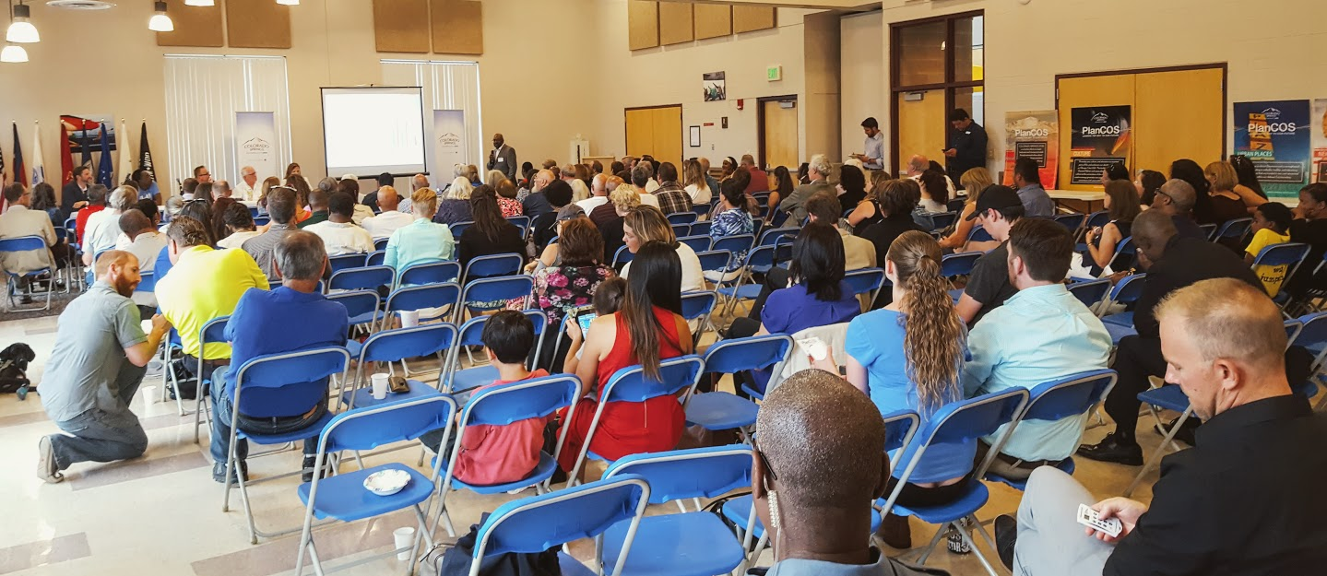
Hot Button Issues- What the Steering Committee has talked most about
Southeast
Attainable/Affordable Housing
Varying Perspectives on the Market
City Role in Design and Urban Form
View Protection

Slide 39
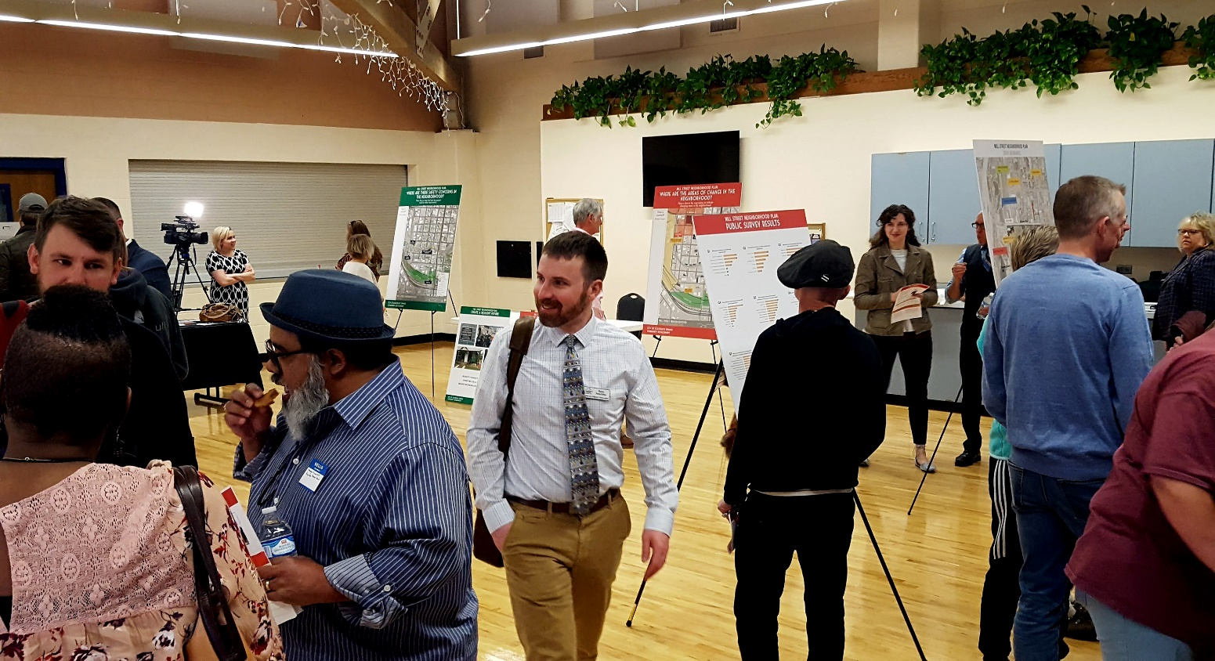
Endorsement & Community Input
Steering Committee
Open Houses
Online Input
Public Service Announcements
Notes:
Steering Committee
Open Houses
Public Service Announcements
Online Input

Slide 40
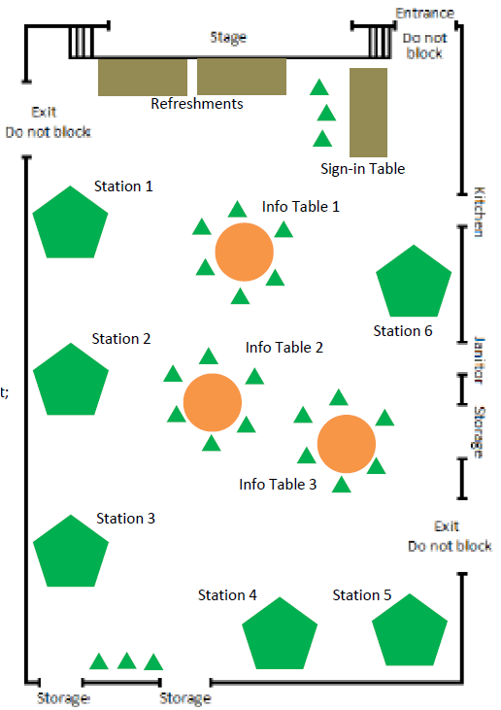
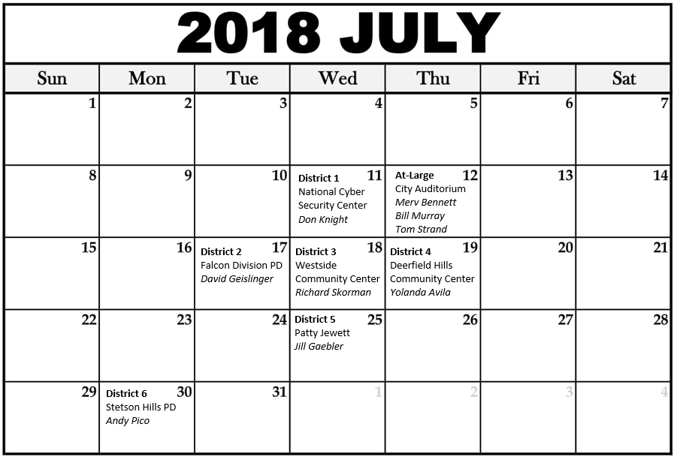
Open Houses
7 Open Houses
1 in each Council District
1 for At-large

Slide 41
Public Service Announcements
SpringsTV productions
PlanCOS Co-Creators and Steering Committee members
Jeannie Orozco (CONO)
Susan Davies (TOPS)
Sean Holveck (Young Professional)
Notes:
SpringsTV
Sean Holveck, Co-Creator
Susan Davies, TOPS
Jeannie Orozco, CONO

Slide 42
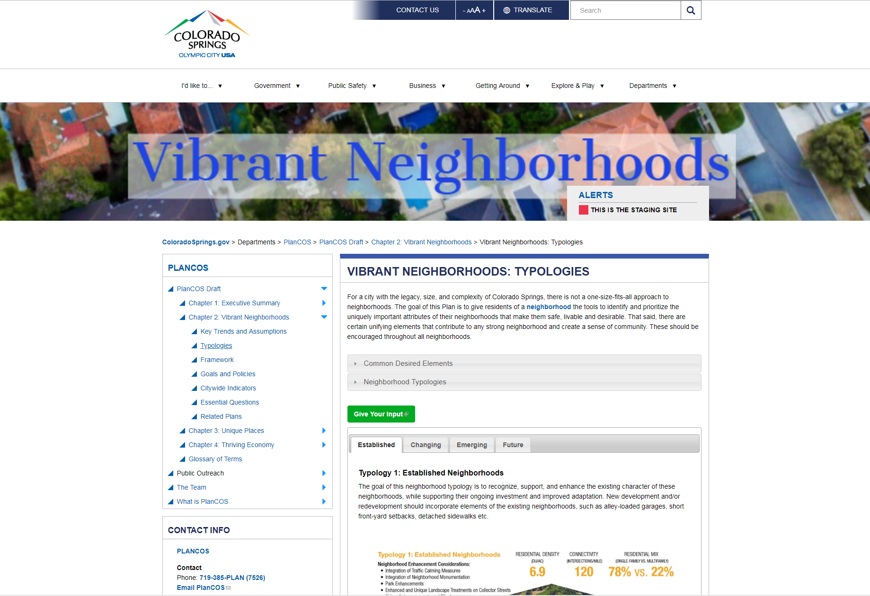
Online Plan
Allows use of latest technology
Videos, photos, interactive maps and graphics
Easy to update with new/relevant examples
Translatable into 104 languages (including English)
Notes:
https://stg.coloradosprings.gov/plancos/page/plancos-chapter-one-executive-summary?mlid=35246

Slide 43
Online Plan
Hawaiian
Japanese
Italian
Notes:
The web-based plan is translatable into multiple languages, including Hawaiian, Japanese, and Italian.
Push the “green button” to comment, and it will take you to SpeakUp! COS

Slide 44
Online Input
Data tracking with single source of public input.
Allows comprehensive analysis
Drop down menu
Chapter Sections
Open-ended with no character limits
Translatable into 104 languages (including English)
Notes:
Speak Up! will feature a drop-down menu of the various chapter sections as well as an open-ended non-character restricted text box.
https://coloradosprings.granicusideas.com/responses/plancos-input-vibrant-neighborhoods

Slide 45
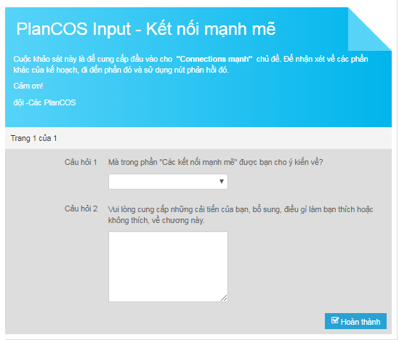
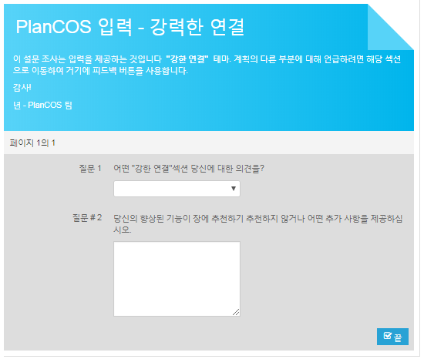
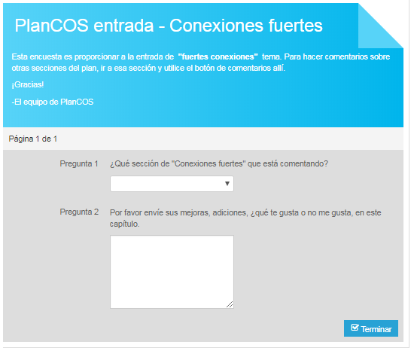
Online Input
Vietnamese
Korean
Spanish
Notes:
In addition, SpeakUp! also offer translation capability

Slide 46
Questions and observations?
Peter Wysocki
pwysocki@springsgov.com
(719)385-5347 (office)
Carl Schueler
cschueler@springsgov.com
(719)385-5391 (office)

